Slide 1
Data Structures, In Detail
CS 374

Slide 2
Hashing/Dictionaries

Slide 3
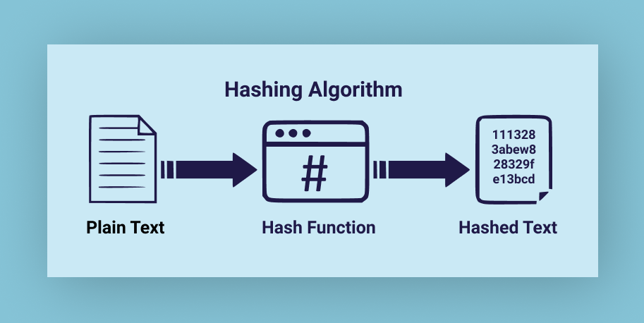

Slide 4
Hashing
A hash is a function that maps keys to an integer.
Used in dictionaries, etc. to help you find it
Also used for cryptography
Have a function, then mod by m to stick it into spot m in the structure
Collisions are an issue – what if two things have same hash?

Slide 5
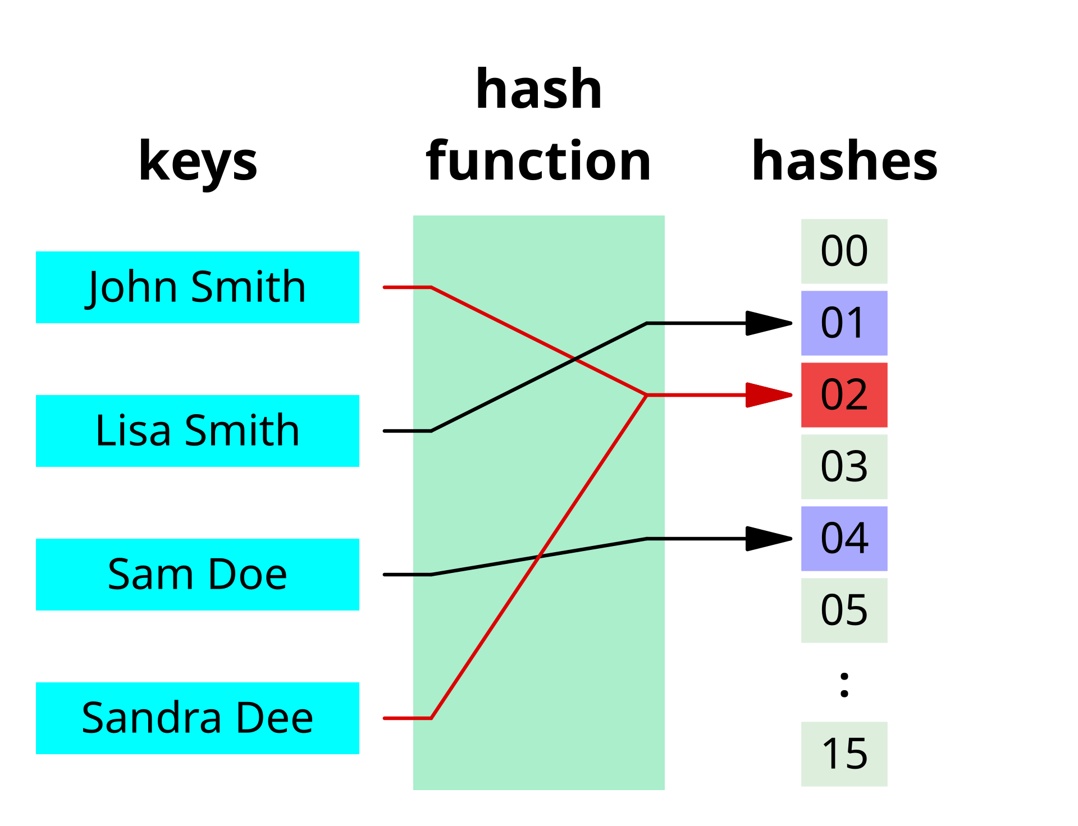

Slide 6

Example
3. Given a hash function of $f(x)=x+31$ mod 11, determine if there is a collision for items inserted with the keys 60, 9, 45, 3, 70, 5, 90, 93, 39, 77, 70 in that order.
At which item does the first collision occur?

Slide 7
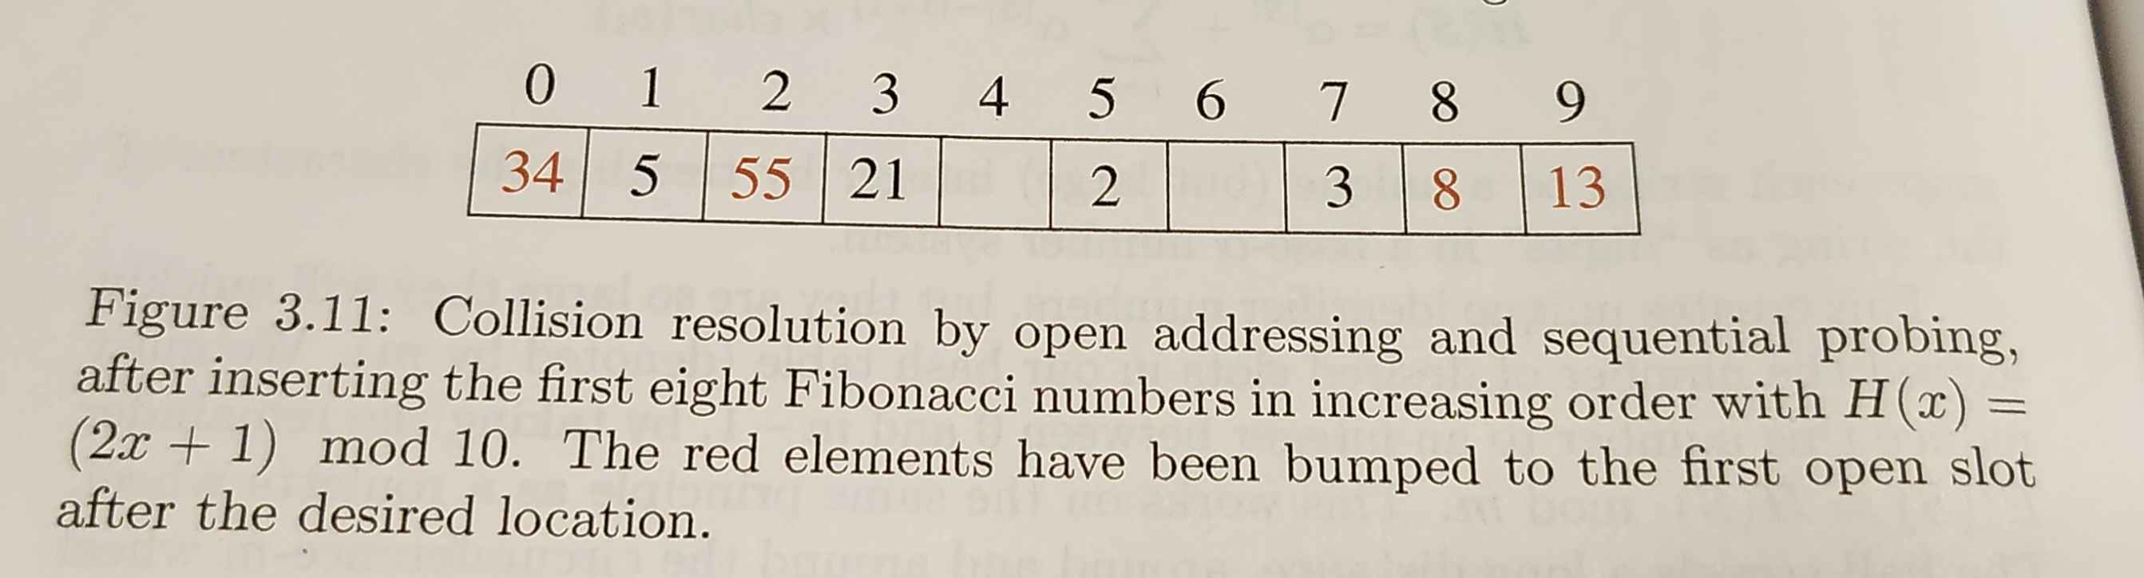

Slide 8
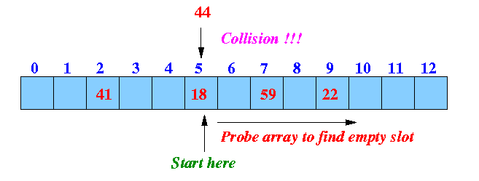
Linear Probing

Slide 9
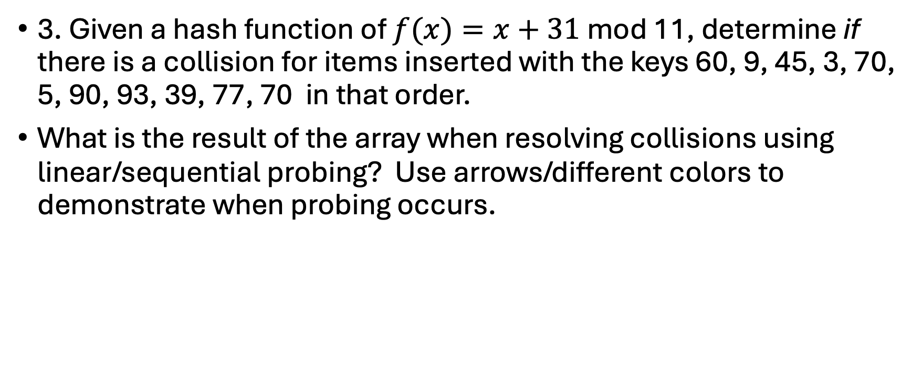
Example
3. Given a hash function of $f(x)=x+31$ mod 11, determine if there is a collision for items inserted with the keys 60, 9, 45, 3, 70, 5, 90, 93, 39, 77, 70 in that order.
What is the result of the array when resolving collisions using linear/sequential probing? Use arrows/different colors to demonstrate when probing occurs.

Slide 10
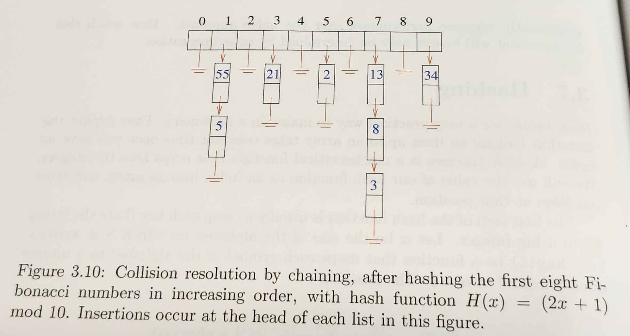
Chaining

Slide 11

Example
3. Given a hash function of $f(x)=x+31$ mod 11, determine if there is a collision for items inserted with the keys 60, 9, 45, 3, 70, 5, 90, 93, 39, 77, 70 in that order.
What is the result of the array when resolving collisions using chaining? Draw a picture.

Slide 12
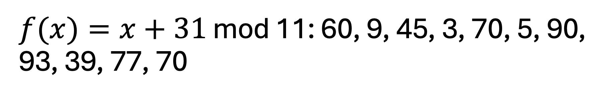
$f(x)=x+31$ mod 11: 60, 9, 45, 3, 70, 5, 90, 93, 39, 77, 70

Slide 13
$f(x)=x+31$ mod 11: 60, 9, 45, 3, 70, 5, 90, 93, 39, 77, 70

Slide 14
More Collision Resolution
Quadratic hashing
If value x matches to y,
Instead of moving y+1, move y+1^{2.}
Then, if y+1² is full, try y+2²
Chances are, you'll find an empty spot faster.
Double hashing
Have a separate hash function that you run when there are collisions
And more!

Slide 15
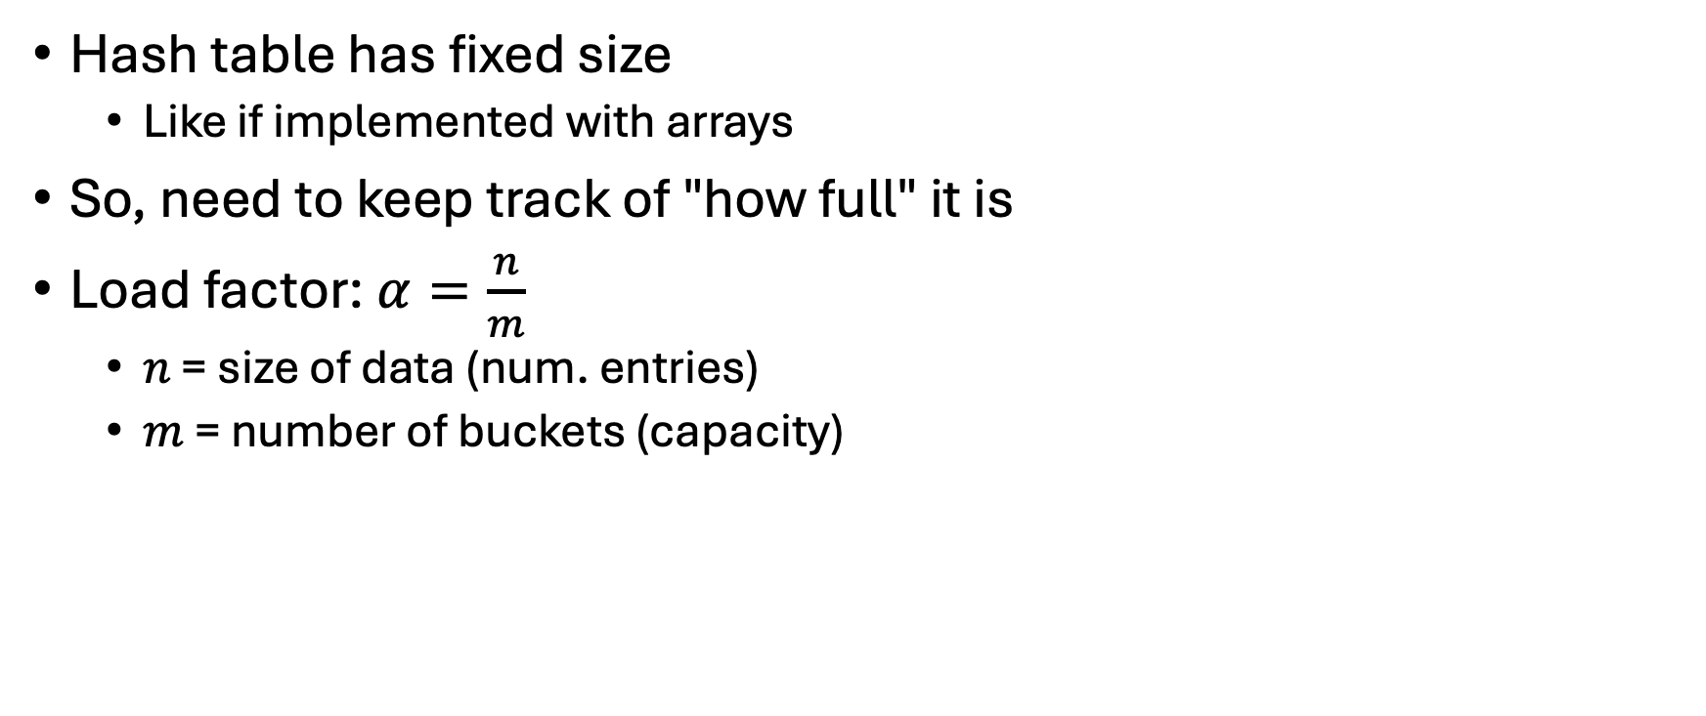
How many things are in there?
Hash table has fixed size
Like if implemented with arrays
So, need to keep track of "how full" it is
Load factor: $α=\frac{n}{m}$
$n$ = size of data (num. entries)
$m$ = number of buckets (capacity)

Slide 16
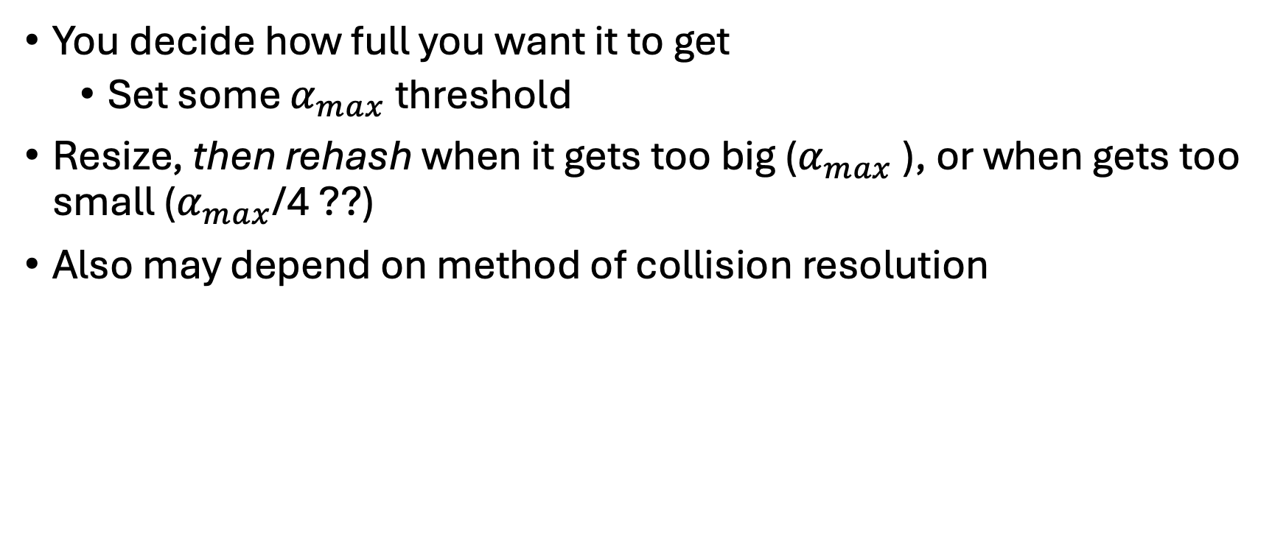
Load factor
You decide how full you want it to get
Set some $α_{max}$ threshold
Resize, then rehash when it gets too big ($α_{max}$ ), or when gets too small ($α_{max}$/4 ??)
Also may depend on method of collision resolution

Slide 17
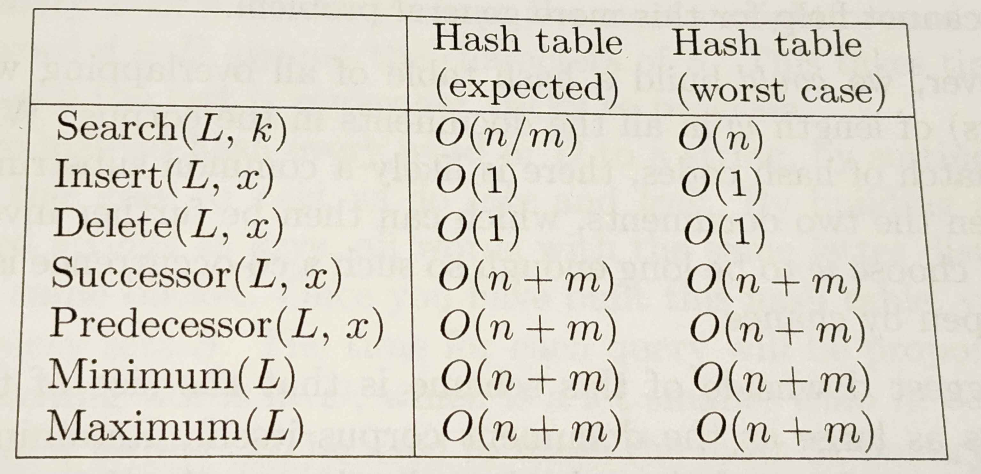
Hash Table Operations

Slide 18
Binary Search Trees

Slide 19
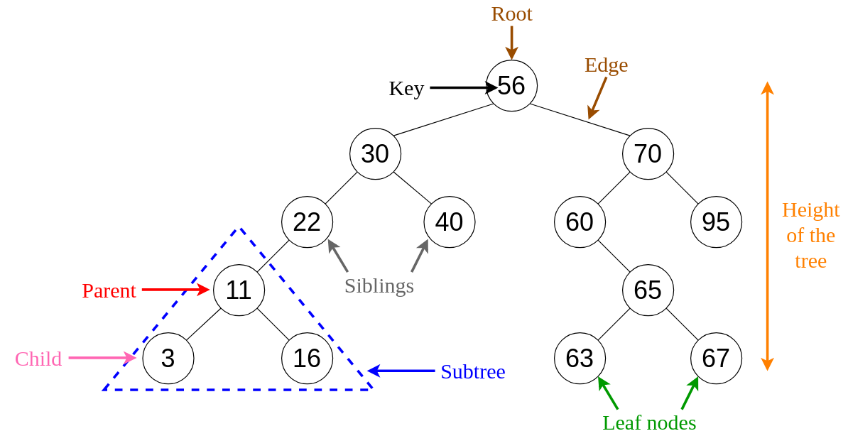

Slide 20
Insert the following items into a BST: 60, 9, 45, 3, 70, 5, 90, 93, 39, 77, 70
Tree A

Slide 21
Insert the following items into a BST: 58 47 84 39 55 14 98 53 79 42 87 3 90 1
Tree B

Slide 22
BST Terms
Complete
All levels full
Balanced
One side not more than other

Slide 23
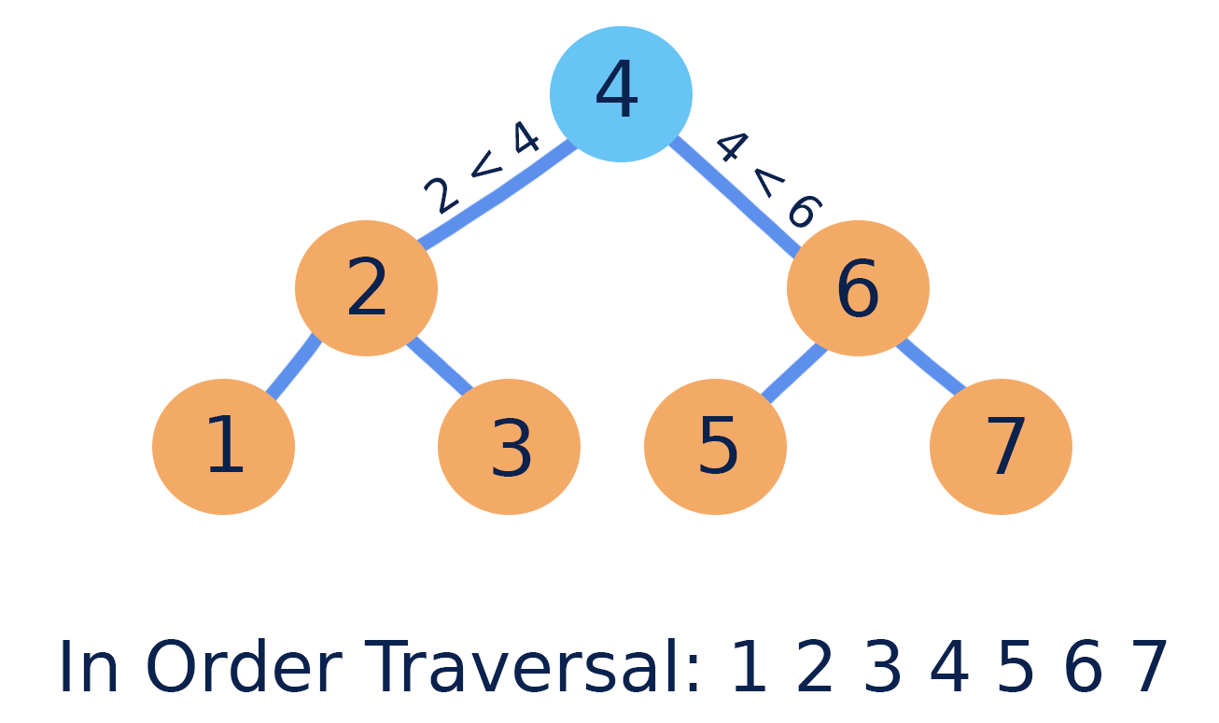

Slide 24
InOrder Traversal of tree A

Slide 25
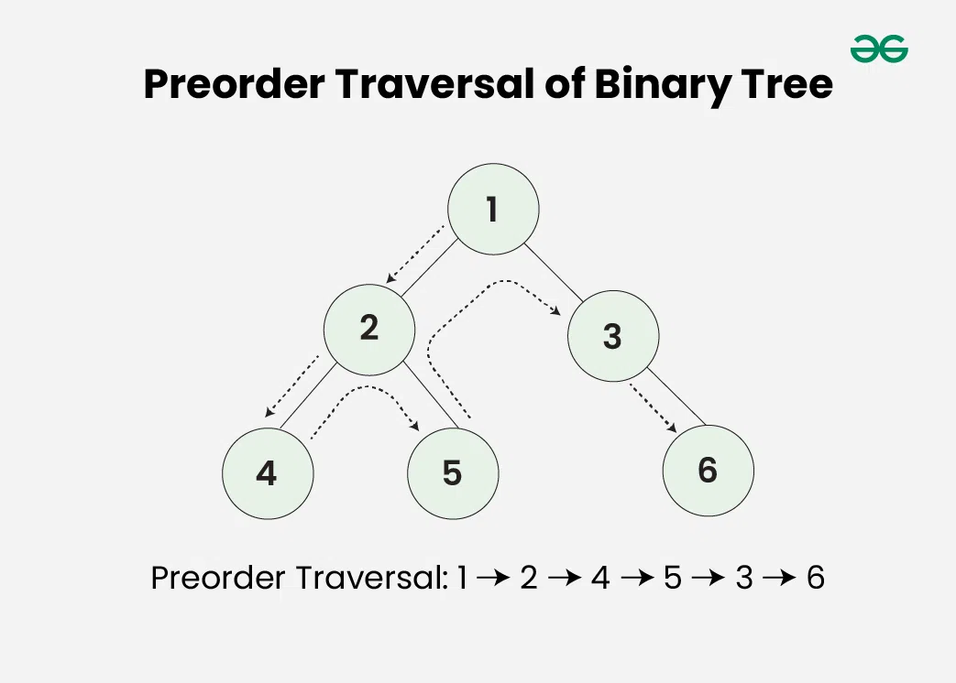

Slide 26
PreOrder Traversal of tree A

Slide 27
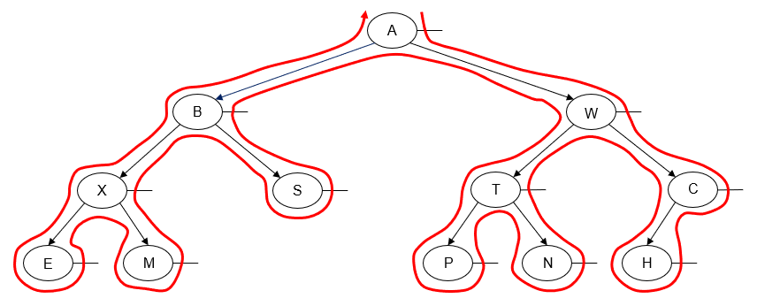
Post-order traversal: E M X S B P N T H C W A
(this isn't a BST, just a BT)

Slide 28
PostOrder Traversal of tree A

Slide 29
BST Operations
Search – O(h), where h= height of tree
Find min/max – O(h)
Traversal – O(n)
Insertion – O(h)
Deletion – O(h)

Slide 30
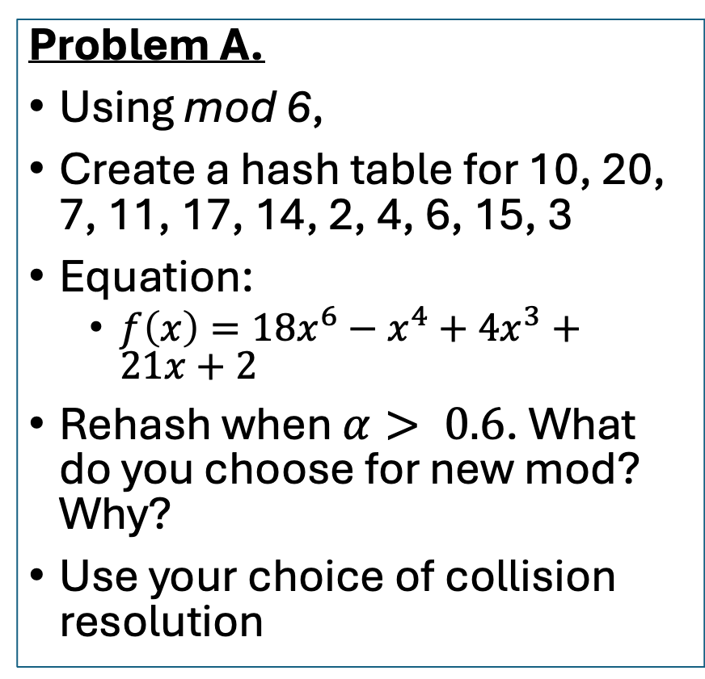
Warm-up Meet up with your teams. On the whiteboard:
Problem A.
Using mod 6,
Create a hash table for 10, 20, 7, 11, 17, 14, 2, 4, 6, 15, 3
Equation:
$f\left(x\right)=18x^{6}−x^{4}+4x^{3}+21x+2$
Rehash when $α> 0.6$. What do you choose for new mod? Why?
Use your choice of collision resolution
Problem B.
Create a binary search tree for 20, 10, 7, 11, 17, 14, 2, 4, 6, 15, 3
Create a binary search tree for 17, 10, 7, 11, 20, 14, 2, 4, 6, 15, 3
These are the same numbers: What's the difference?

Slide 31
Heaps

Slide 32
Heaps
Min-heap: smaller = at the top
Max-heap: larger = at the top
Complete binary tree
All levels are filled…
…except maybe the last one
Last level gets filled Left to Right.

Slide 33
Heap – Insertion
Insert latest item in bottommost, leftmost position.
"Bubble up" if necessary.
Swap the item with its parent until heap property is not violated
Also called "heapify", sometimes "heapify up"

Slide 34
Example: Insert the following numbers into a min-heap. 18, 12, 3, 7, 15, 4, 11, 16, 5, 14. Then draw the array.

Slide 36
Heap – Deletion
Remove the item at the root
Move the "last" thing in the heap to the root
"Bubble down" if necessary.
Check the children.
Swap the item with the smaller of the children
Continue swapping item down, so the smaller thing gets swapped up.
Also called "heapify", sometimes "heapify down"

Slide 37
Remove 2 things from the preceding heap.

Slide 39
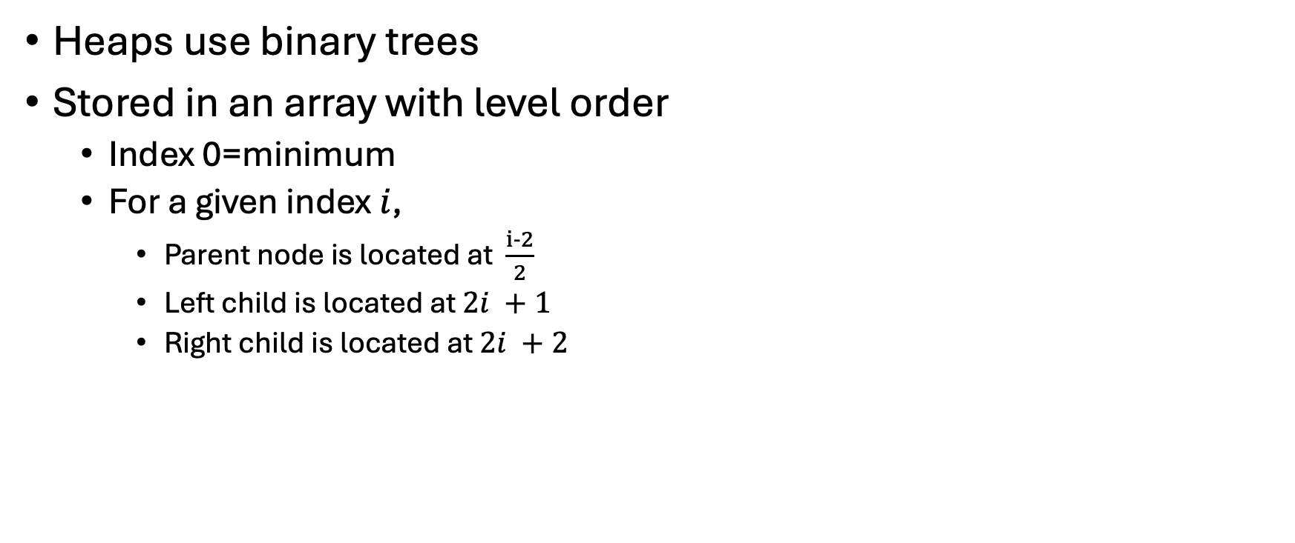
Heaps – that's great, but how does it code???
Heaps use binary trees
Stored in an array with level order
Index 0=minimum
For a given index $i$,
Parent node is located at $\frac{i−2}{2}$
Left child is located at $2i +1$
Right child is located at $2i +2$

Slide 40
Heap – Search
Ehhh not really
Used to find the *min* element
So don't worry about it!

Slide 41
What do we use heaps for?
Priority queues!
Min-heap removal always gives the minimum element.

Slide 42
Heap Complexity

Slide 43
Draw the max-heap for the following numbers, then remove 3 elements. 3, 14, 4, 8, 15, 16, 9, 12, 20

Slide 44
Cool-Down: Solve my to-do list
Task | Deadline | Dr. Roscoe's Priority
Grade Algorithms HW 1 | Tuesday | 1
Knit hat | March 31 | 5
Read a research paper | Friday | 2
Post the Stats homework | 5pm today | 2
Submit Jan Term proposal | Sunday 11:59pm | 1
Post Algorithms video | 5pm today | 1
Write a section of research paper | 5pm today | 1
Discuss on what variable or combination of variables you will optimize.
Describe on the board how you will construct a priority queue, and use a heap to return the order of tasks I should complete, until the queue is empty.

Slide 45
Warm-up: Does heap insert order matter?
Insert the following lists of numbers into a heap. Do they produce the same heap?
19, 27, 13, 26, 11, 24, 18, 10, 1, 30, 28, 14, 5, 15, 4, 8, 12, 23
11, 1, 8, 5, 10, 24, 14, 18, 26, 4, 19, 13, 15, 30, 27, 23, 28, 12
24, 27, 11, 4, 8, 5, 1, 23, 12, 30, 18, 28, 19, 15, 14, 10, 13, 26

Slide 46
Union-Find / Disjoint Sets

Slide 47
Outline
Analogy
Trees
In arrays
Code
Optimizations

Slide 48
Let's start a company
You're wondering why I've brought you all here today…
Everyone is working on something different.
You get a number 1-26 to represent your various projects/expertises

Slide 49
Let's start a company
Hang on, some of you are working on similar things.
I will put you in different "departments"
pairs/groups of 3

Slide 50
Someone has to be in charge
Between you, designate someone to be your "manager".
Even if you have a direct supervisor, you still have a manager.
When I ask you which group you're part of, respond with the name of your ultimate manager.
This operation is called find()

Slide 51
Merging Departments
Merging 2 departments:
One of the two existing managers gets to be ultimate manager
Can't have 2 managers
The result is 1 department with 1 manager.
This operation is called union().
Specifically,

Slide 52
Union-Find / Disjoint Sets
A data structure that performs 2 main operations:
Union(x,y)
Combine two departments based on any two people in those departments.
Find(x)
Return who x's ultimate manager is.

Slide 53
Union-Find uses a Forest
Forest = group of un-connected trees
Each tree in the forest is a connected group
A department, identified by its ultimate manager
Merging departments means combining trees under a common root

Slide 54
Union Find: that's great, but how does it code???
Remind me: What's an element of an array?
Remind me: What's an index of an array?

Slide 55
Union Find: that's great, but how does it code???
Each element corresponds to an array index.
Space: O(n)
Elements not nice integers?
Use a Hashmap/dictionary. Map elements to integers.
The item at each element is the name of the "manager"
If 5's root is 2, the element at index 5 is 2

Slide 56
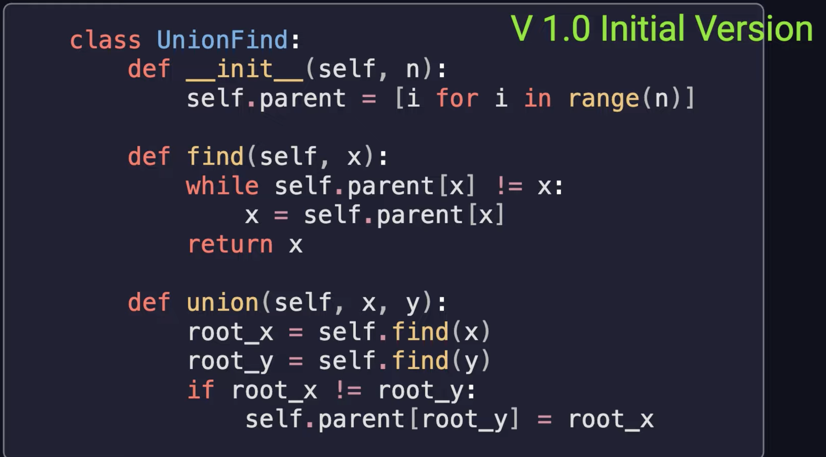
Code
From https://www.youtube.com/watch?v=92UpvDXc8fs

Slide 57
Example: with 10-element array
Break ties with a preference for smaller numbers.
Union(5, 9)
Union( 3, 1)
Union( 8, 6)
Union( 9, 2)
Union( 4, 7)
Union(8, 0)
Union( 7, 1)
Union( 9, 4)
Union( 2, 3)
Union( 6, 5)
What is find(5)?
0 1 2 3 4 5 6 7 8 9

Slide 58
It's not perfect
Haphazard union-ing could result in a linear structure

Slide 59
Making it better – By Rank / By Size
Union by …
Rank = height of the tree
Size = number of elements in the tree
Keep track of this in a separate array
Only need to keep track of the root's rank or size

Slide 60
Making it better – Path Compression
When finding, if we aren't directly reporting to the manager, make it so we do directly report to the manager.
Redraw edges of the tree
Makes the tree wide, but fast lookup.

Slide 61
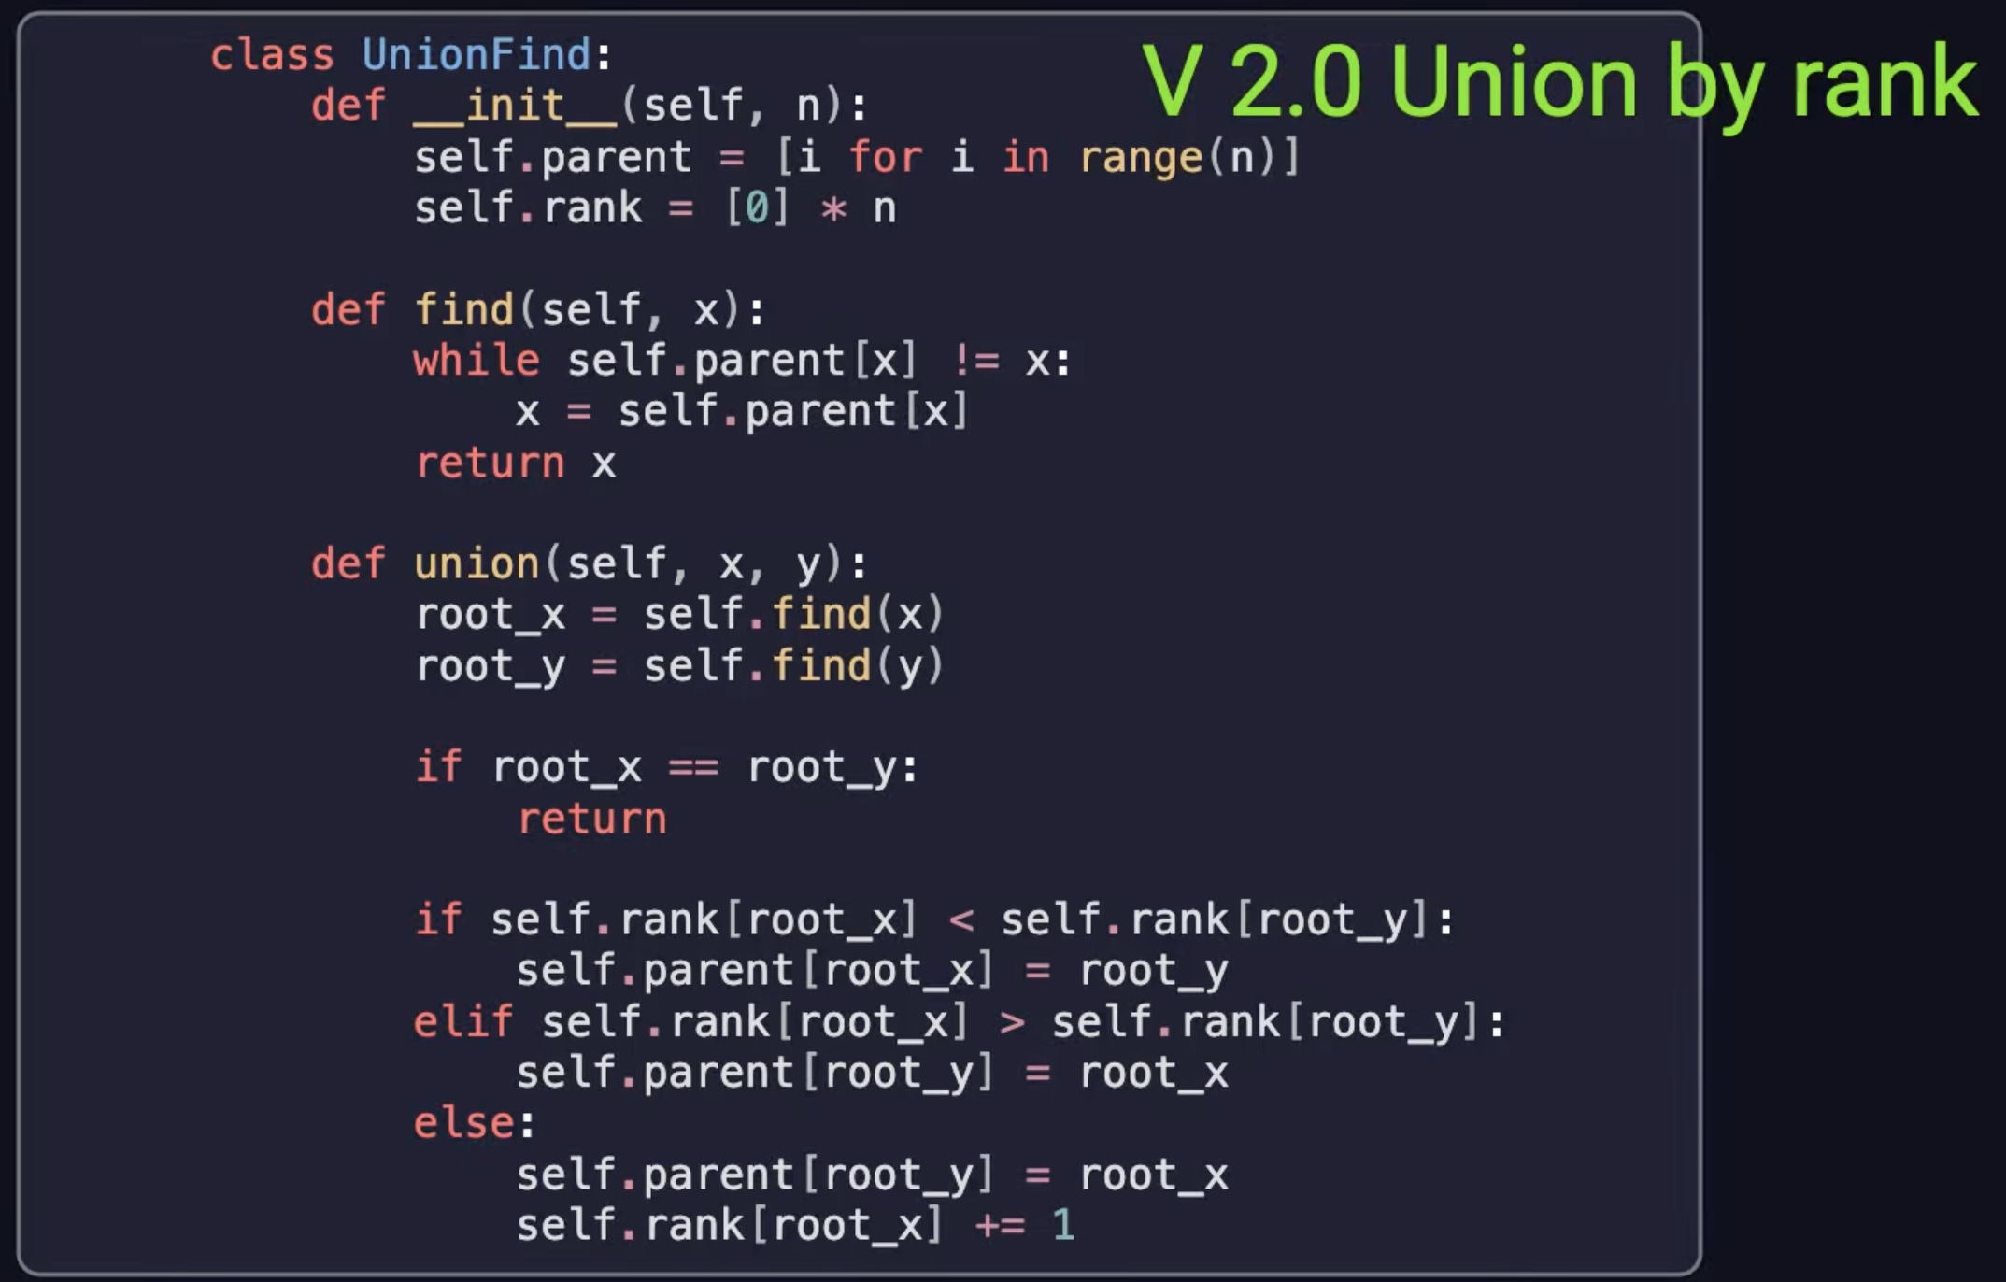
Code version 2
From https://www.youtube.com/watch?v=92UpvDXc8fs

Slide 62
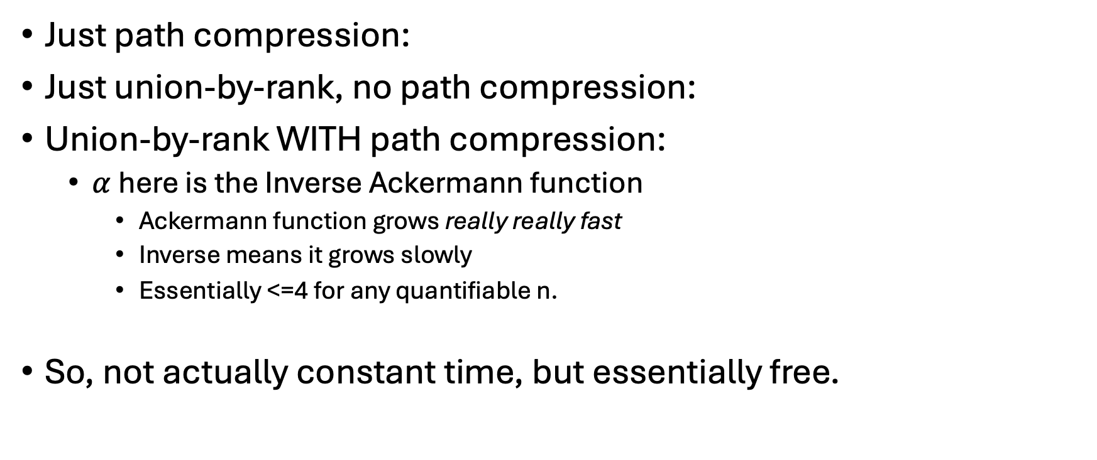
Complexity of Union-Find
Just path compression:
Just union-by-rank, no path compression:
Union-by-rank WITH path compression:
$α$here is the Inverse Ackermann function
Ackermann function grows really really fast
Inverse means it grows slowly
Essentially <=4 for any quantifiable n.
So, not actually constant time, but essentially free.

Slide 63
Applications
Finding a minimum spanning tree
Kruskal's MST algorithm
How many connected components of a graph are there?
Easy-to-implement and efficient graph algorithms have wide-reaching effects.

Slide 64
Cool-Down
In your teams, visualize a sequence of Union-Find operations as an array and as a forest. Use by-rank and path optimization. Break ties with a preference for smaller numbers.
Union(7,1)
Union(4,2)
Union(8,5)
Union(0,3)
Union(6,9)
Union(2,7)
Union(5,9)
Union(8,1)
Union(4,6)
What is Find(4)?

Slide 65
Cool-Down
Complete "Number of Provinces" LeetCode problem using UnionFind
https://leetcode.com/problems/number-of-provinces

Slide 66
Further Exploration
https://en.wikipedia.org/wiki/Disjoint-set_data_structure#
https://en.wikipedia.org/wiki/Ackermann_function#Inverse
https://www.youtube.com/watch?v=92UpvDXc8fs
https://www.youtube.com/watch?v=8f1XPm4WOUc

Slide 67
These slides are work-in-progress; more will be added

